Slide 1
Unit 7: Lists /Queues/Stack
At the end of this unit, you should be able to:
Explain the principal difference between Lists and Sets
Name and use some of the indexed methods of the List interface
Name two JCF classes which implement List, and distinguish between them
Write programs which declare, create and manipulate Lists
Integrate Collections, Sets and Lists in a single application to manipulate a collection of data in different ways
Desirable but non-examinable objective:
Use ListIterators and subLists in connection with LinkedList
Be aware of the queue-related methods in LinkedList
Slide <number>
Notes:
OOP3Slides2 Collections. A nic G

Slide 2
Sample Programs
NameList
NameQueue
SubjectList
ReversedFriendsList
Slide <number>
Notes:
OOP3Slides2 Collections. A nic G

Slide 3
List: java.util.List<E>
A List is an ordered collection (sometimes called a sequence):
  an applicant’s CAO course choices
  the shopping items scanned through a checkout
Lists can contain duplicate elements.
The user of a List generally has precise control over where in the list each element is inserted.
Elements can be accessed by their integer index (position).
The add( ) method always puts an item at the end of the list
Slide <number>
Notes:
OOP3Slides2 Collections. A nic G

Slide 4
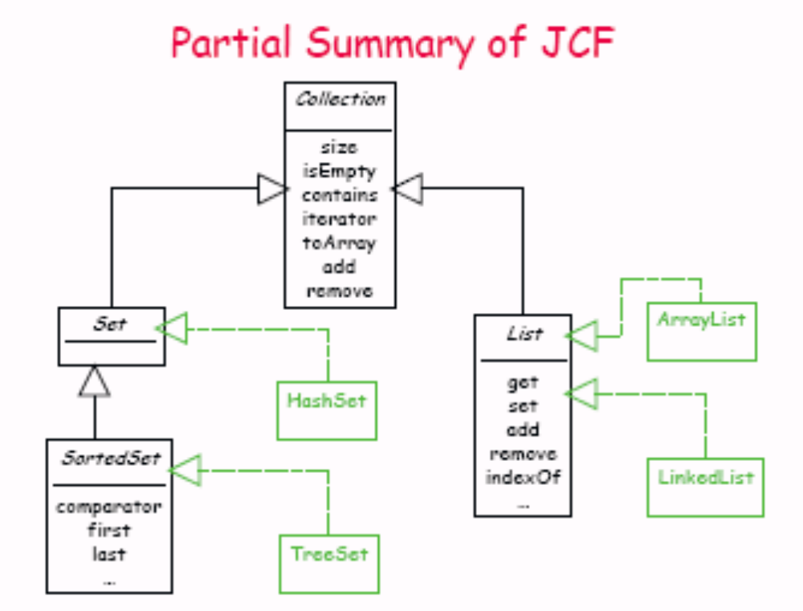
Slide <number>
Notes:
OOP3Slides2 Collections. A nic G

Slide 5
Some List methods:
(in addition to those inherited from Collection):
public E get (int index);
  Returns the item at position index in the list
public E set (int index, E x);
  Places x at position index, replacing previous item; returns the previous item
public void add (int index, E x);
  Places x at position index, shifting items to make room
public E remove (int index);
  Remove item at position index, shifting items to fill the space; returns the removed item
public int indexOf (Object x);
  Returns the index of the first item in the list that equals x (x.equals())
Slide <number>
Notes:
OOP3Slides2 Collections. A nic G

Slide 6
Using Lists
To use a list in a program, we must create an instance of a class that implements the List interface.
Two classes implement the List interface:
  ArrayList
  LinkedList
ArrayList uses an array to manage data.
LinkedList class uses a technique called linked-node representation.
Slide <number>
Notes:
OOP3Slides2 Collections. A nic G
Because both the ArrayList and LinkedList classes implement the same interface, we know that instances of ArrayList and LinkedList behave the same way, i.e., they support the same set of public methods defined in the List interface.

Slide 7
Operational Efficiencies
ArrayList
  Holds data internally as an array
  Random access is fast, just “index into” the array
  Insertion (except at the end) is very slow
LinkedList
  Random access is slow (but provided for)
  Insertion anywhere is fast (once you are there!)
Slide <number>
Notes:
OOP3Slides2 Collections. A nic G

Slide 8
Which List class?
ArrayList will be faster if the program needs to do a lot of indexed ‘get’ operations
LinkedList will be faster if the program needs to do a lot of inserting and removing, or mainly traverses the list from start to finish
Slide <number>
Notes:
OOP3Slides2 Collections. A nic G

Slide 9
List Implementations
java.util.ArrayList<E> (an array; expands via array-doubling)
Constructors
  public ArrayList ( );
  public ArrayList (int initialCapacity);
  public ArrayList (Collection<? extends E> c);
java.util.LinkedList <E> (a doubly-linked list)
Constructors
  public LinkedList ( );
  public LinkedList (Collection<? extends E> c);
Both include some additional useful methods specific to that class
LinkedList implements the interface Queue
Slide <number>
Notes:
OOP3Slides2 Collections. A nic G

Slide 10
List Example: NameList.java
public class NameList {
public static void main (String args[]){
// create an ArrayList of strings
List<String> names = new ArrayList<String>();
// add some names to it
names.add("Bernadine");
names.add("Elizabeth");
names.add("Gene");
names.add("Elizabeth");
names.add("Clara");
// display the whole lot
System.out.println(names);
// Display the name in position 2
System.out.println("2: " + names.get(2));
}}
Slide <number>
Notes:
OOP3Slides2 Collections. A nic G

Slide 11
Exercise
Use the conversion constructor to create a TreeSet containing the elements of names, and display them:
the duplicates will disappear, and the remaining names will be in alphabetical order
Slide <number>
Notes:
OOP3Slides2 Collections. A nic G

Slide 12
Example: list of Persons
import java.util.*;
List<Person> friends;
Person person;
friends = new ArrayList<Person>( );
person = new Person(“Jane", 10, 'F');
friends.add( person );
person = new Person(“Jack", 6, 'M');
friends.add( person );
// get the second person in the list
person = friends.get( 1 );
// (try this by adding the last line to GenericFriendsList1.java)
Slide <number>
Notes:
OOP3Slides2 Collections. A nic G

Slide 13
ArrayList and Generics
Example
The Student class encapsulates a student. A Student object holds
      a student’s name
      his/her ID number.
The Student class has getter and setter methods.
Student overrides the equals(Object o) method inherited from Object so that two students are equal if they have the same name and ID number.

Slide 14
ArrayList and Generics
public class Student
{
private String name;
private String id;
public Student()
{
name = "";
id = "";
}
public Student (String n, String idNum)
{
name = n;
id = idNum;
}
public String getName()
{
return name;
}
public String getID()
{
return id;
}

Slide 15
ArrayList and Generics
public void setName(String n)
{
name = n;
}
public void setID( String idNum)
{
id = idNum;
}
public boolean equals(Object o) // name and id are the same
{
return ( (((Student)o).name).equals(name) &&
(((Student)o).id).equals(id) );
}
}

Slide 16
ArrayList and Generics
Example
The Institute holds a “King for a Day” lottery.
A student can participate by entering his/her name and ID
number into a pool of candidates. The winner is selected randomly from all entries.
Each student is allowed one entry.

Slide 17
ArrayList and Generics
Problem Statement
Implement a class, StudentLottery, with methods that
enter students in the “King for a Day” lottery, and
pick a winner from the entries.
The application should check that no student enters the lottery more than once.

Slide 18
ArrayList and Generics
Solution
The StudentLottery class uses an ArrayList, entries, to hold Student references.
The class has methods:
  void addStudents() that enters students in the lottery and
  void pickWinner().
pickWinner() uses the Random class to select one winner from among all student entries.
addStudents() checks that there are no duplicate entries.
When all students are entered, the name of the winning student and his/her ID are displayed.

Slide 19
ArrayList and Generics
import java.util.*;
public class SchoolLottery
{
private ArrayList<Student> entries;// holds Student references
public SchoolLottery()
{
entries = new ArrayList<Student>(250); // initial capacity is 250
}

Slide 20
ArrayList and Generics
public void addStudents()
{
// prompts for student names and ID numbers
// adds students to entries list
// does not allow duplicate entries
Scanner input = new Scanner(System.in);
System.out.println("Press Enter to end input");
System.out.print("Name: ");
String name = input.nextLine();

Slide 21
ArrayList and Generics
do
{
System.out.print("ID: ");
String id = input.nextLine();
Student student = new Student(name, id);
if (!entries.contains(student)) //only one entry per student
{
entries.add(student);
System.out.println(name + " entered in the lottery.");
}
else
System.out.println(name + " not entered.");
System.out.print("\nName: ");
name = input.nextLine();
} while (! name.equals(""));// signals end of data
pickWinner();
}

Slide 22
ArrayList and Generics
public void pickWinner()
{
// chooses a random entry and displays winners name and ID
int numEntries = entries.size();// size of ArrayList
Random random = new Random();
Student winner = entries.get(random.nextInt(numEntries));
System.out.print("The winner and King for a Day is ");
System.out.println (winner.getName());
System.out.println (winner.getID());
}
public static void main(String[] args)
{
SchoolLottery lottery = new SchoolLottery();
lottery.addStudents();
}
}

Slide 23
Queue
A queue is a collection used to hold multiple elements prior to processing:
  the item at the head of the Q is processed first
  once an item has been processed, it is removed from the Q
Besides basic Collection operations, a Queue provides additional insertion, extraction, and inspection operations, such as poll() which returns the first item and removes it.
Queues typically, but not necessarily, order elements in a FIFO (first-in, first-out) manner.
‘Priority’ queues are also possible
Slide <number>
Notes:
OOP3Slides2 Collections. A nic G

Slide 24
Queue Example (NameQueue.java)
// Create a LinkedList of Strings
LinkedList<String> nameQueue = new
LinkedList<String>();
// Add names to it, each at the head of the queue
nameQueue.addFirst("Bernadine");
nameQueue.addFirst("Elizabeth");
nameQueue.addFirst("Gene");
nameQueue.addFirst("Elizabeth");
nameQueue.addFirst("Clara");
// display them in order: last one is at top
System.out.println(nameQueue);
// remove the last two, and display again
nameQueue.removeLast();
nameQueue.removeLast();
// display them again
System.out.println(nameQueue);
System.out.println("\nServing the first person, who is " + nameQueue.poll());
Slide <number>
Notes:
OOP3Slides2 Collections. A nic G

Slide 25
Using different collection types to process an array of Strings
Algorithm:
Initialise an array of Strings representing subject proposals coming before a course board
Assign this array to a Collection reference by using the asList() method from Arrays, and create an ArrayList from it
To get rid of the duplicates, create a HashSet from the ArrayList
To get them into alphabetic order, create a TreeSet from the HashSet
To check that we didn’t lose any, check that the TreeSet ‘containsAll’ of the original subjects
Slide <number>
Notes:
OOP3Slides2 Collections. A nic G

Slide 26
Integrating several Collection types: SubjectList.java
public static void main (String args[]){
String[] proposedSubjects = {"Linux News","PHP","Java","XML","Perl",
"Linux Development","PHP","XML","Web-Services",
"Linux Tools", "IT Management", "Security" ,
"Java", "J2EE", "XML" };
// Create a Collection from the Array, using a method from Arrays
Collection<String> convertedSubjects =
Arrays.asList(proposedSubjects);
//Create an ArrayList instance from the Collection
List<String> osdnSubjects =
new ArrayList<String> (convertedSubjects);
// Create a HashSet instance from the List to get rid of duplicates:
Set<String> uniqueSubjects = new HashSet<String> (osdnSubjects);
Slide <number>
Notes:
OOP3Slides2 Collections. A nic G

Slide 27
SubjectList.java continued..
// How many subjects have we got: use size():
JOPane.showMessageDialog(null,“Proposals: " + osdnSubjects.size() );
JOPane.showMessageDialog(null,“Unique Proposals: " +
uniqueSubjects.size());
// Create a TreeSet instance from the List to get a sorted set
  SortedSet<String> sortedSubjects =
  new TreeSet<String> (osdnSubjects);
// Check that we didn’t lose any of the original subjects
  boolean alliswell = sortedSubjects.containsAll(osdnSubjects);
  JOptionPane.showMessageDialog(null,
  "Do we still have every subject from the start : "+ alliswell);
Slide <number>
Notes:
OOP3Slides2 Collections. A nic G

Slide 28
Polymorphic method to display any collection using an iterator
private static JTextArea area; // declared outside of main, hence static
// this method will display any collection
public static void display(Collection c){
Iterator iter = c.iterator();
while (iter.hasNext())
area.append(iter.next() + "\n");
JOptionPane.showMessageDialog(null,area);
}
// in main:
area = new JTextArea()
area.setText("Initial list of subjects\n\n");
display(osdnSubjects); // an ArrayList
area.setText("Set of subjects without the duplicates\n\n");
display(uniqueSubjects); // a HashSet
Slide <number>
Notes:
OOP3Slides2 Collections. A nic G

Slide 29
List method subList()
The List interface provides a method subList(int fromIndex, int toIndex) which allows us to work with a subsection of the List
Changes to the sublist have an effect on the underlying List
The element at ‘fromIndex’ is included, but the element at ‘toIndex’ is not
Slide <number>
Notes:
OOP3Slides2 Collections. A nic G

Slide 30
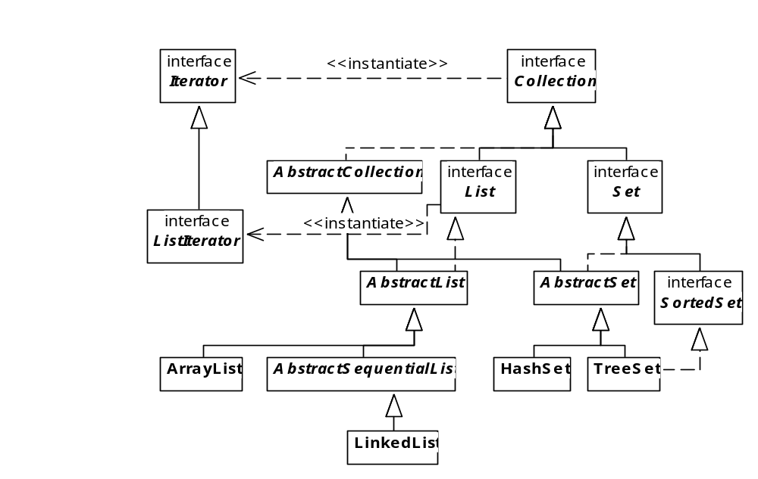
Lists have ListIterators
Slide <number>
Notes:
OOP3Slides2 Collections. A nic G

Slide 31
ListIterator
ListIterators provide various ways of iterating through lists, including going backwards
List has two methods to supply a ListIterator:
  ListIterator listIterator()
  ListIterator listIterator(int startIndex)
Using the second constructor the programmer can position the iterator beyond the end of the list, then work backwards using the ‘previous’ method.
Slide <number>
Notes:
OOP3Slides2 Collections. A nic G

Slide 32
Some ListIterator methods
void add(Object)
boolean hasNext()
boolean hasPrevious()
Object next()
int nextIndex()
Object previous()
int previousIndex()
void remove()
void set(Object) (this does replacement)
Slide <number>
Notes:
OOP3Slides2 Collections. A nic G

Slide 33
Iterating backwards thru a List
List<Person> friends;
friends = new ArrayList<Person>( );
// populate as in previous examples, then display forwards:
System.out.println(friends);
// Display the list in reverse, positioning the iterator
// just after the end of the list:
ListIterator<Person> it =
friends.listIterator(friends.size());
while (it.hasPrevious())
System.out.println(it.previous());
// ReversedFriendsList.java
// note that this could also be done using a ‘for’ loop
Slide <number>
Notes:
OOP3Slides2 Collections. A nic G

Slide 34
Stack
A stack is a ordered list of data such that items can be added to and removed from just one end of the list, the top of the stack.
Access to a stack is more restrictive than access to an ArrayList.
When you add an item to the top of the stack you push the item onto the
stack.
When you remove the top item from a stack, you pop the stack.

Slide 35
Stack
If s is a stack of strings that is initially empty, the operations
    push “Hamlet”,
    push “Rosencranz”, and
    push “Guildenstern”
place the three strings on s.
Because “Guildenstern” is the last string pushed onto s,
“Guildenstern” occupies the top position.

Slide 36

Stack
A stack after three push operations

Slide 37

Stack
Two pop operations, remove the top two
strings from s.

Slide 38
Stack Implementation
The standard stack operations include:
  push: add an element the stack.
  pop: remove and return the top element of the stack .
  peek: view or “peek at” the top of the stack.
  empty: determine whether or not there are any elements in the stack.
  size: get the number of elements stored in the stack.

Slide 39
Stack Example
A Stack For Checking Balanced Parentheses, Brackets, and Braces
Expressions and statements typically include parentheses, braces and brackets; syntactically correct expressions require balanced parentheses, braces, and brackets. For example, the parentheses in the expression ((2+3) * 3) are balanced; but those in ((2+3) * 3 are not. The parentheses and brackets of array[2*(3+4)] are balanced but the brackets of array[2*(3+4)[ are not.

Slide 40
Stack Example
With the aid of a stack, determining whether or not the parentheses, braces, and brackets of an expression are balanced is an easy task that is specified by the following algorithm.
initialize a stack to empty
for each character, ch, of an expression
if ch is a left parenthesis (, brace {, or bracket [
push ch onto the stack
if ch is a right parenthesis, brace, or bracket
if a matching left parenthesis, brace, or bracket is on top of the stack
pop the stack
else
report an error and stop
// No characters remain as input.
if the stack is empty, the expression is correctly balanced. Otherwise, it is not

Slide 41
Using a stack to check that ([2+3]–(a +b) +1) is balanced
Stack String Action
empty | ([2+3]-(a +b) +1) | Push (
( | [2+3]-(a +b) +1) | Push [
( [ (top) | 2+3]-(a +b) +1) | read 2
( [ | +3]-(a +b) +1) | read +
( [ | 3]-(a +b) +1) | read 3
( [ | ]-(a +b) +1) | read ]– Pop the matching left bracket [
( | -(a +b) +1) | read the -
( | (a +b) +1) | Push (
( ( | a +b) +1) | read a
( ( | +b) +1) | read +
( ( | b) +1) | read b
( ( | ) +1) | read ) –Pop the matching left parenthesis (
( | +1) | read +
( | 1) | read 1
( | ) | read ) -- Pop the matching left parenthesis (
empty | end of string | The expression is balanced.

Slide 42
Stack Example
Problem Statement:
Implement a class with a single utility method,
public static void boolean expressionChecker( String ex),
that determines whether or not the
parentheses, braces, and brackets of ex are
balanced. Include a main(…) method that
tests expressionChecker(…).

Slide 43
Stack Example
import java.util.*;
public class ExpressionChecker
{
public static boolean checkExpression(String ex)
{
Stack<Character> stack = new Stack<Character>();
for (int i = 0; i < ex.length(); i++)
{
char ch = ex.charAt(i);
// if ch is a left parenthesis, brace, or bracket push ch onto the stack
if (ch == '(' || ch == '[' || ch == '{')
stack.push(ch);
// if ch is a left parenthesis and there is a matching right parenthesis
//on the stack, pop
else if (ch == ')' && (!stack.empty()) && stack.peek().equals( '('))
stack.pop();
// if ch is a left bracket and there is a matching right bracket on the stack, pop
else if (ch == ']' && (!stack.empty()) && stack.peek().equals( '['))
stack.pop();

Slide 44
Stack Example
// if ch is a left brace and there is a matching right brace on the stack, pop
else if (ch == '}' && (!stack.empty()) &&
stack.peek().equals('{'))
stack.pop();
// if ch is a left parenthesis, bracket, or brace with no match on the stack,error
else if (ch== ')' || ch == ']' || ch == '}')
return false; // expression is incorrect
}
if (!stack.empty())
return false;
return true;
}

Slide 45
Stack Example
public static void main(String [] args)
{
Scanner input = new Scanner(System.in);
System.out.println("Enter an expression; press <ENTER> to exit");
System.out.print(": ");
String expression = input.nextLine();
do
{
boolean correct = checkExpression(expression);
if (correct)
System.out.println("Expression "+ expression+ " is correct");
else
System.out.println("Expression "+ expression+ " is incorrect");
System.out.print("\n: ");
expression = input.nextLine();
} while (!expression.equals(""));
}
}

Slide 46
Stack Example
Output:
Enter an expression; press <ENTER> to exit
: (1+3)* (3+5)*4
Expression (1+3)* (3+5)*4 is correct
: (1+3)*x[3-2]+(a+5
Expression (1+3)*x[3-2]+(a+5 is incorrect
: array[3+(4+5]
Expression array[3+(4+5] is incorrect

Slide 47
Stack Example
Discussion
The statement on line 6 instantiates a Stack<Character> object. However, the statement on line 12
stack.push(ch);
pushes a primitive value onto the stack.
Autoboxing invisibly wraps the value of ch with a Character
object. The statement stack.push(ch) is akin to
stack.push(new Character(ch)).

